Slide 1
“WE ARE LOOKING FORWARD TO BEING YOUR PARTNER ”

Slide 2
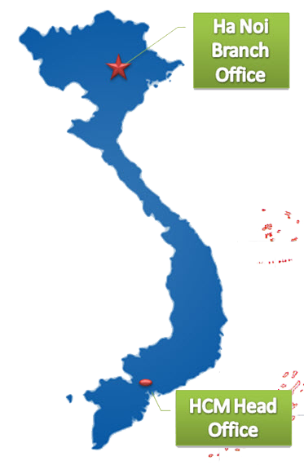
INTRODUCTION
40HRS. Inc. was founded
In the year 2000 in San Jose,
California USA.
40HRS Vietnam was established in 2011 with Head Office in Ho Chi Minh and Branch Office in Ha Noi.

Slide 3
INTRODUCTION
40HRS INC. was founded in the year 2000 in San Jose, CA, USA. Today we have a team of bright, talented recruiters that give the firm a balance of experience and breadth of in-depth exposure to various industries including: Supply chain, rapid delivery, IT, Banking, High-tech manufacturing & engineering, trading and services.
40HRS ASIA provides service to our current customer base as well as support new business in this rapidly growing region focused on Singapore, China and Vietnam. Our business expansion strategy includes Shanghai and, Shenzhen in China, and Malaysia, Taiwan and other countries in Asia.
40HRS Vietnam was established in 2011 with the head office in Ho Chi Minh and the Ha Noi branch office. We pride ourselves in having a talented local team with unique areas of expertise recognized as the best in Vietnam with proven track records. Our main services are: HR consulting, management consulting, recruitment, and outsourcing. Our added services are legal consulting, training and insurance.
Most of our Recruitment Consultants have more than 10 years of working experiences in their respective professions, with experience in recruitment and managing people for , FMCG, supply chain, manufacturing, engineering, IT, Banking, trading, services and others.

Slide 4
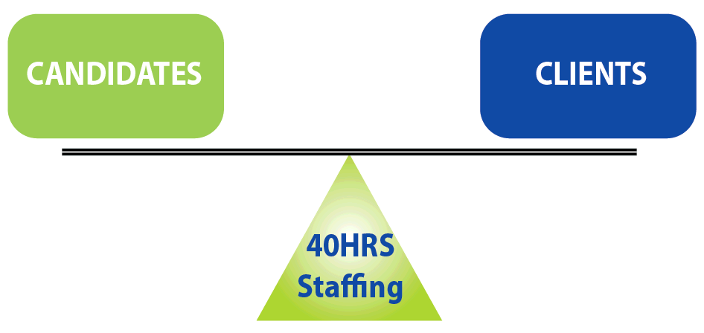
BALANCED APPROACH
Together
Each
Achieve
More

Slide 5
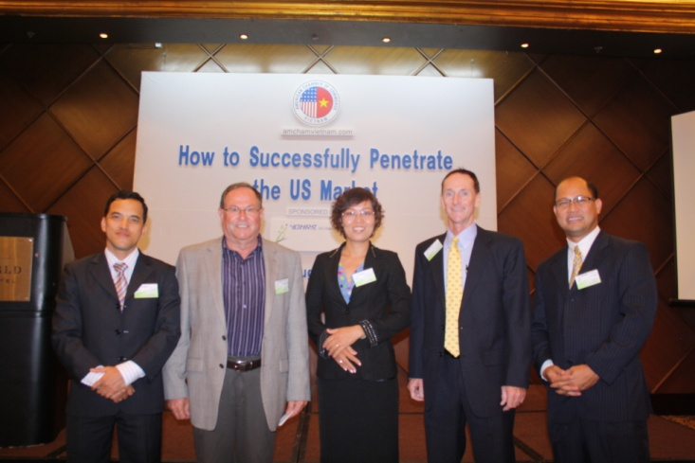
OUR TEAM
Our Management team has over 20 years working experience in a broad range of industries. And, most especially, they are premier in recruiting & HR consulting in a wide range of local & multinational companies.
Most of our Recruitment Consultants have more than 10 years of working experience in their respective professions with particular skill in recruiting and managing people.
Our people are the best!

Slide 6
CORE VALUE
SLOGAN
THE POWER OF RESULTS
4 weeks maximum to find out suitable candidates for clients.
0 complaint from clients & candidates about our services.
H onor to serve clients & candidates at any times.
R ights of clients & candidates are highly respected.
S ave time & money while working with 40hrs.

Slide 7
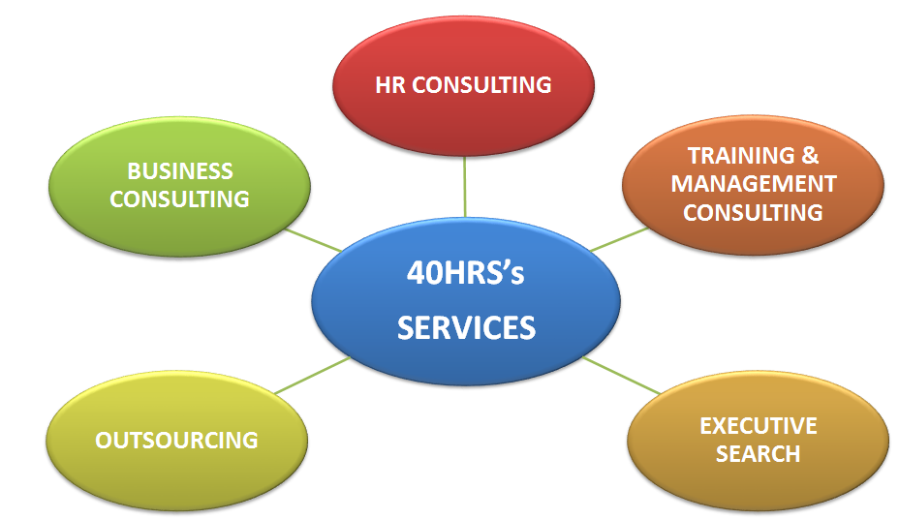
40HRS’ BUSINESS SERVICES

Slide 8
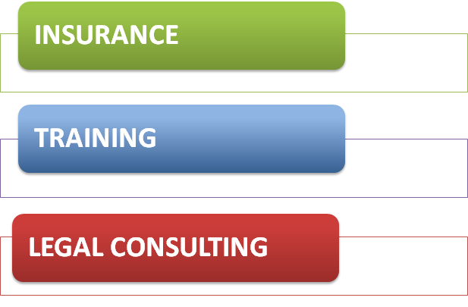
40HRS’ ADDED SERVICES

Slide 9
RECRUITMENT PROCESS
RECRUITMENT PROCESS DESIGN
RECRUITMENT STRATEGY
SEARCHING & SCREENING
SHORTLISTING & INTERVIEWING
HIRING
ON-BOARDING
Each hire is critical & make the right choice

Slide 10
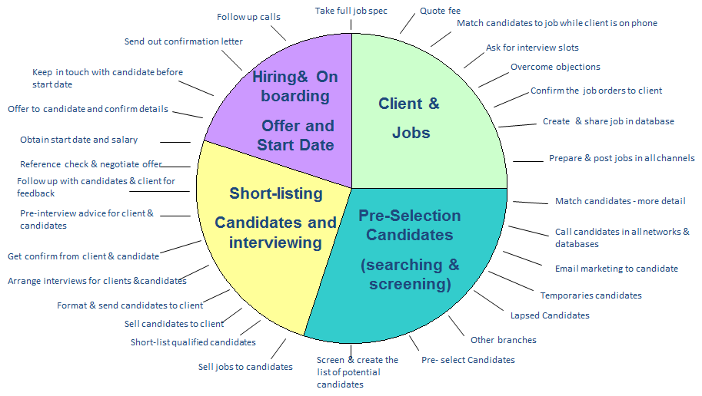
THE CYCLE - TAKING A JOB TO PLACING A CANDIDATE

Slide 11
OUR NETWORKS WITH EXPERT CONSULTANTS

Slide 12
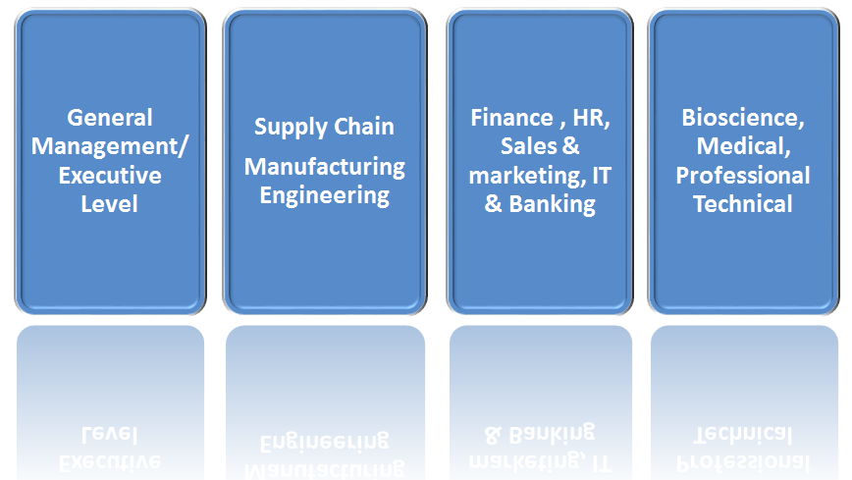
OUR EXPERTS CONSULTING FIELDS

Slide 13
OUR CLIENTS and more…..
Review our clients’ testimonial on our website: www.40hrs.vn

Slide 14
THANK YOU
WE LOOK FORWARD TO SERVING YOU

